Slide 1
Remote
Gatekeeping
System
3rd Year Project
Group 19
E/17/027 Pubudu Bandara
E/17/090 Achintha Harshamal
E/17/219 Ishara Nawarathna

Slide 2

REAL WORLD PROBLEM,
MOTIVATION,
AND THE SOLUTION

Slide 3
What we see today...
The uprise of COVID-19 pandemic
Sudden surge of Online Deliveries
The workforce of Sri Lanka
1.5X YoY growth of online buyers with a 2.5X growth of Online Orders
19.1%
works in public sector.
All of them are work in between 8am to 5pm,
5 days a week
Retail and Recreation trends have declined by 17% compared to baseline
Google COVID-19
Community Mobility Report
E-Commerce Index :
Powered by daraz
January ‘19 - December ‘19
2020 Annual Report
Central Bank of Sri Lanka
Notes:
The google covid19 community mobility report says that there is a 17% decreasement of retail and recreation trends. This is mainly due to because the people are adopted to buy online and get online deliveries to their home due covid situation. THis is clearly indicates in the e commerce index of daraz and it says that 1.5 times growth of active online buyers and 2.5 times growth online orders. So there is a direct correlation between covid19 and the increasement of online deliveries.
Next the big point is , 2020 annual report of the central bank of Sri Lanka says that 19.1% works in public sector between 8 am to 5 pm. So there is a good chance of not being in the house when the online deliveries comes.also There can be a chance that there are home alone children at the house when online delivery comes to the door.

Slide 4
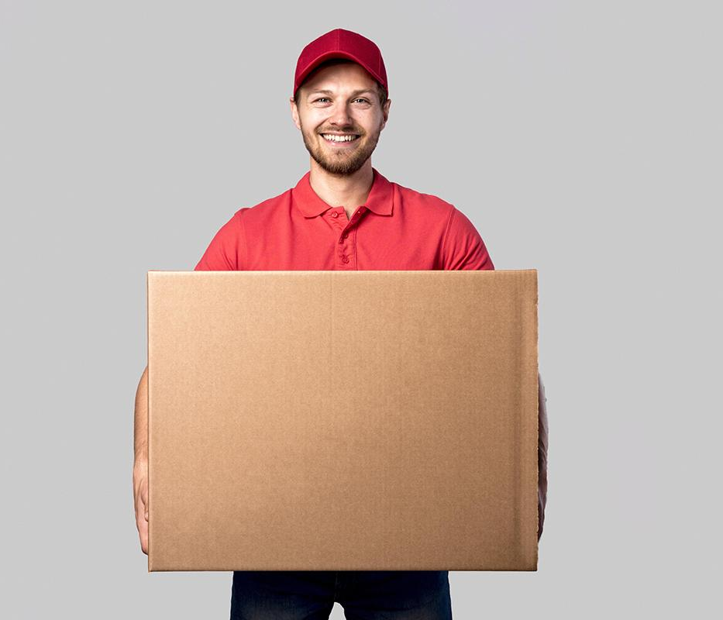
Real World Problems and The Opportunity
Safety of the deliveries can not be guaranteed and can be lost when the home owners are not home.
When the parents are not home , it makes a risky environment for children if an outsider (visitors/delivery person) comes to the house.
The ongoing pandemic restricts people to have physical interactions (with visitors, relations, etc.)
Notes:
*Some delivery people are adopt to keep the delivery package at outside of the house/gate when homeowners are not at the house.That is not safe to the delivery package and it can be damaged due to some reasons such as rainy situations. Also there is a change of losing the delivery package.
*The people are afraid to interact with any outsiders due to the covid pandemic situation. So it would be good if we can introduce a solution so that we can get the least human interaction with outsiders.
Risky, Unsafe, Not Reliable, Inefficient

Slide 5
Our goal is to introduce a system, to communicate remotely with an outsider who is at our gate or to undertaking deliveries,
without making physical interactions.
Notes:
Our goal is to introduce a system, to communicate remotely with an outsider who is at our gate or to undertaking deliveries, without making physical interactions

Slide 6
Solution : Remote Gatekeeping System
Smart Mailbox
Mobile controlling interface
Remote Gate unlocking system
Web interface
Control unit with intercom
Notes:
Smart mailbox - which can be operate remotely by the user
Remote gate…-
Control unit… -most important part of the system, which makes communications with the server
Mobile... - which is the main end-point of the system where the user interacts with
Admin… - provides infrastructures and services to maintain the system

Slide 7
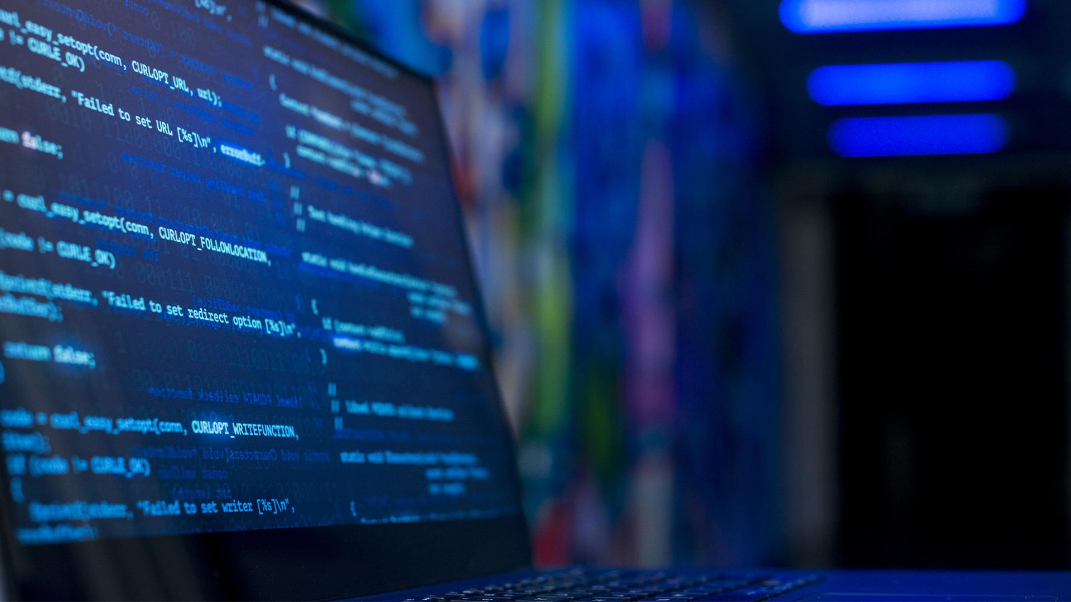
Solution Architecture
and the components
of the system

Slide 8
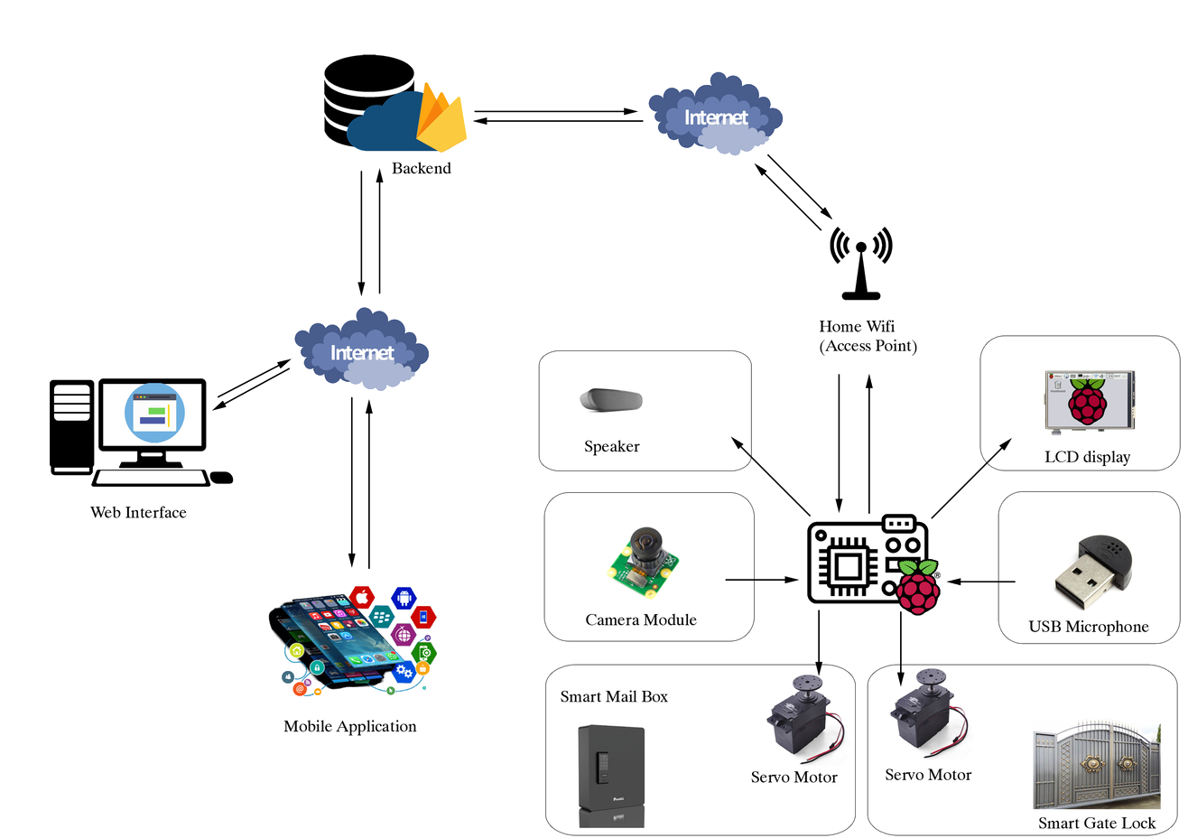
High-level System Organization

Slide 9
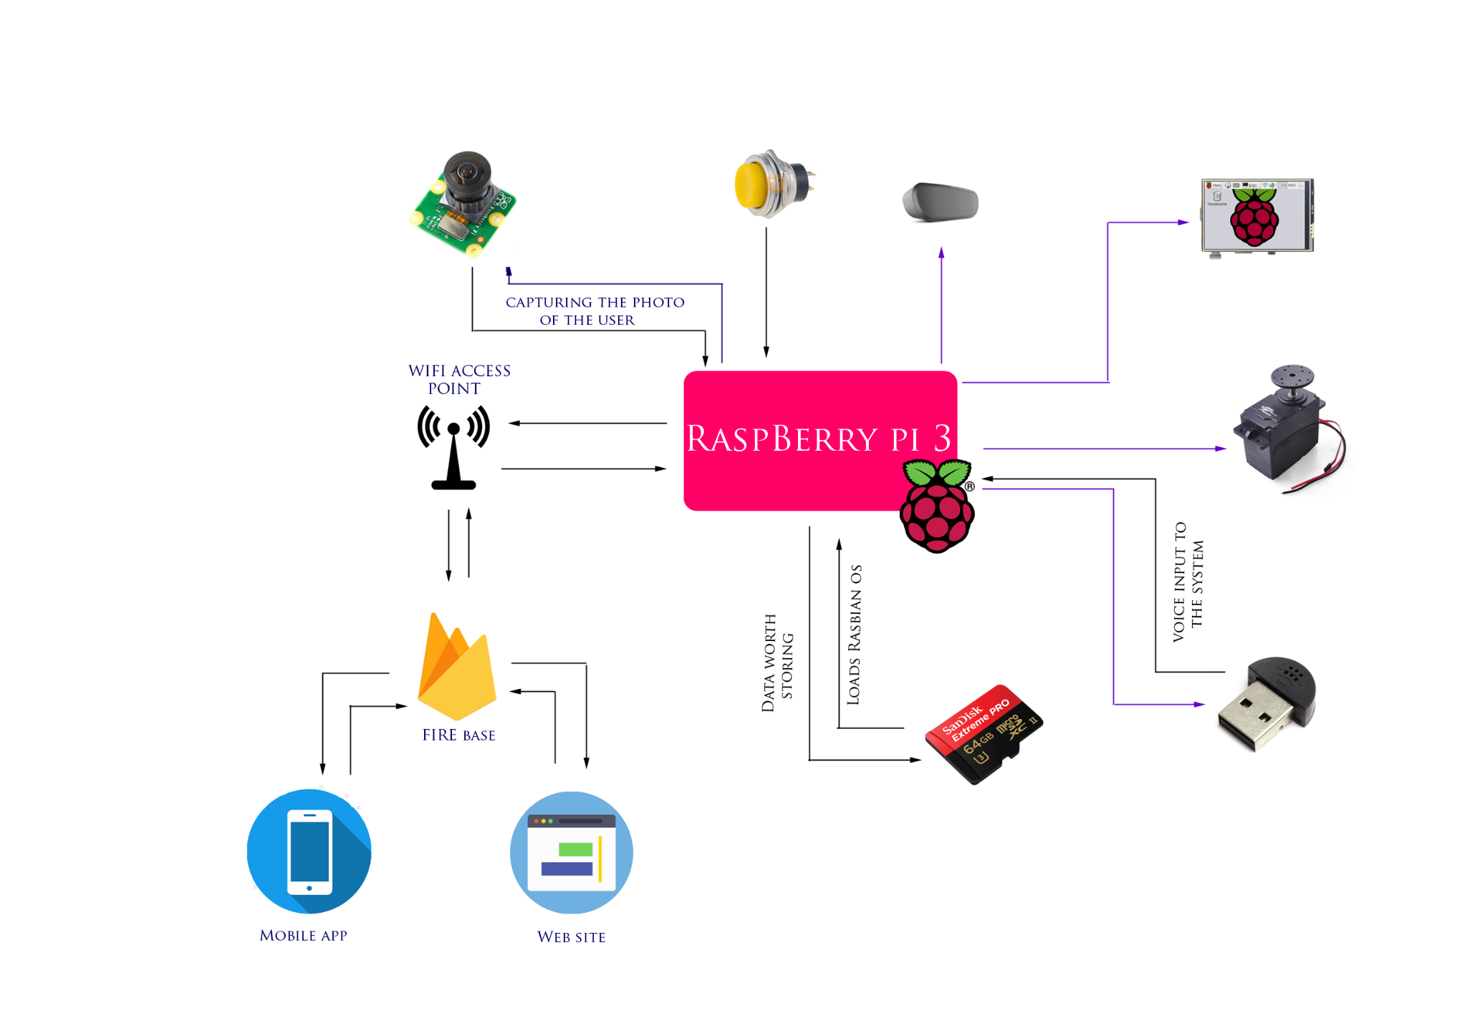
Data and Control Flow of the Design

Slide 10
Users - Who’s going to interact with the system
Inside-User:
The owner of the house
Outside-User:
Person who wants to communicate with insiders
Mainly interact with the Mobile Application.
Mainly interacts with the IoT device

Slide 11
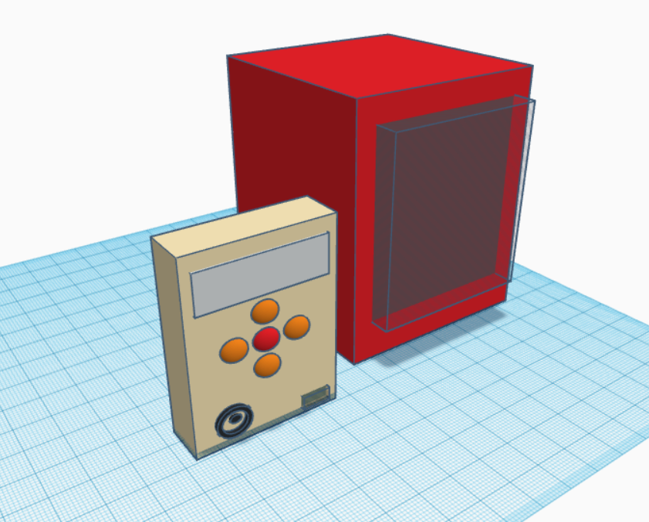
Components of system
Control Unit
Controlling the smart mailbox and smart gate lock.
Capture the photo of the outsider.
Outsider can enter their contact information and also request for the inside user contact information.
Outsider can intercom with the insider user using voice message.
Notes:
The main node of physical side of the system
Make communications with the Inside-End users wire the Cloud Server
Give commands to operate Mailbox and the Gate Unlocking device
Takes inputs from the Outside-End user and provide relevant outputs

Slide 12
Smart Mailbox
Used to safely receive and store the delivery packages.
Can be locked and unlocked as the request of the delivery person.
Gate lock/unlocking system
Used to lock and unlock the gate remotely.
Can be locked and unlocked as the request of the outsider.
Controlled by the inside user using the mobile application.
Unlocking and Locking is achieved by the turning the servo motor clockwise and anticlockwise.

Slide 13
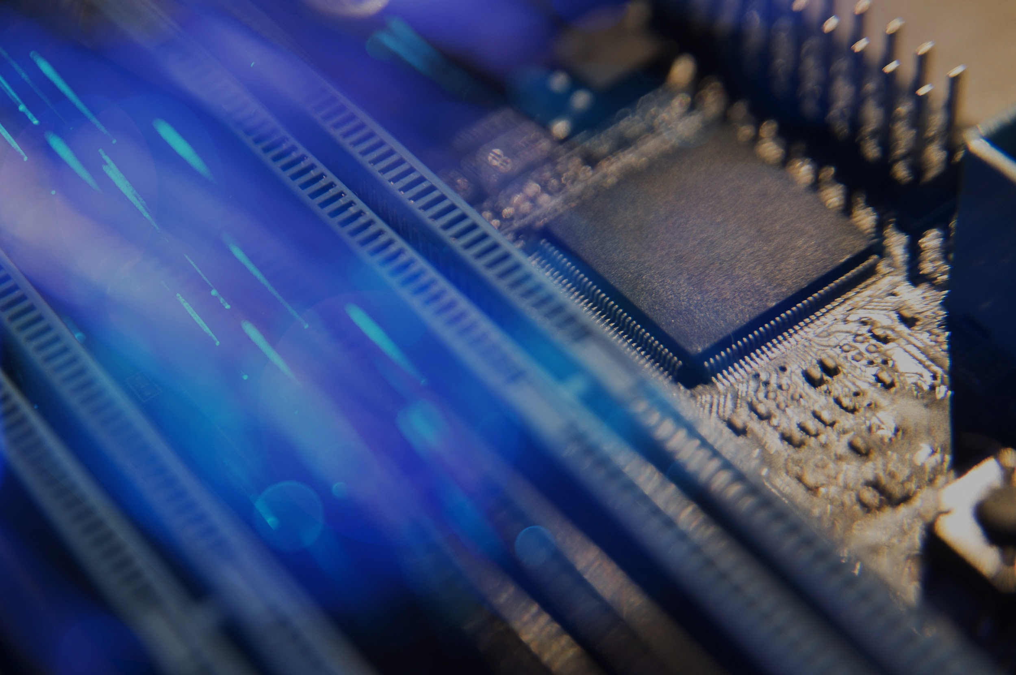
Software level and hardware level
Technologies of the System

Slide 14
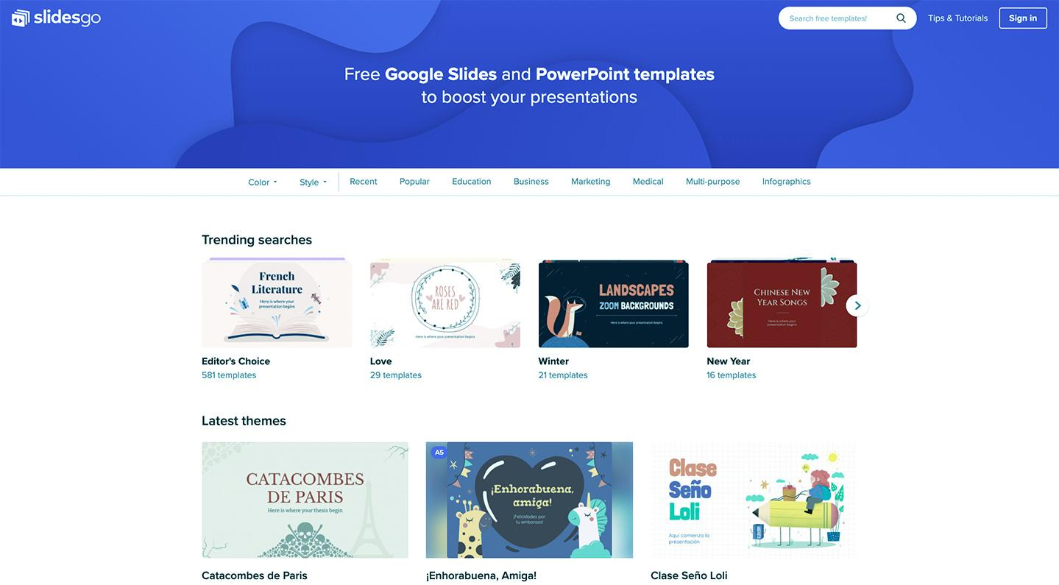
Mobile Application
The Insider can response to the various requests of the outsider.
Informing through real time notification.
Intercom
Accessing the Smart Mailbox/
Smart Gate lock
Capture a photo of the
outsider
Web Application
Initializing the system.
Registering the user to the system.
Establishing the connection between the user account and the IoT device.
Download the mobile application.
Notes:
Initialize the system.
Register a user
Connection established with a node
The admin panel handles the authentication process
New accounts/nodes to the system
Handling disconnected nodes
Maintains the system
Troubleshooting
Upgrading & Testing

Slide 15





Technologies to be used...
Raspberry pi 3
Python 3
Firebase
ReactJS
React Native
IoT Platform
Programming
Language
Backend
Services
Web App
Development
Mobile App
Development

Slide 16
Why we chose them?
We considered about the following aspects . . .
Features and performance
Cost
Documentation
Community Support
Cross-platform Support
...
Notes:
Power Consumption
weight and size
Time limitation of the product

Slide 17
Technologies, explained...
Raspberry Pi 3 Model B
Python 3
1.2GHz 64-bit CPU -
1GB RAM -
40-pin extended GPIO -
Inbuilt network module -
- Vast community support
- Web frameworks (Django, Flask)
- Fast programing and wide array
of libraries
React
Firebase
Both mobile and web app - development .
Free and open source -
Multi platform support -
- Authentication, Web hosting
- NoSQL database
- Free tier
- Good for Real-time Apps
Notes:
General purpose io ports
Free tier: No payment for smaller projects
ALL OF THEM COLLECTIVELY

Slide 18
Security and Privacy Concerns
Privacy of the user data
(audio files, images, personal information, etc.)
User authentication (User identification)
Cannot be accessed by the admins
while transmitting or at the storage
The outsiders can take the informations
only at Inside-End user’s will
Data should not be accessible to the attackers
All the technologies we use are highly secure and well maintained

Slide 19

Demonstration Plan
A full demonstration virtually or in real time, including;
Completed User Interfaces
User Registration
A complete interaction between the two end users
Completed hardware module (by the end of Short Semester)
Notes:
-Two people : roles of inside user and outside user
-A full demonstration will be presented , containing,
-How an user register to the system.
-How to connect the system to the backend platform.
-How to use the device and what features are available when an outsider is at our door.
-Demonstration of the front ends.

Slide 20
Project Timeline
Week 6
Week 7
Week 8
Week 9
Week 10
Week 11
Week 12
Week 13
Week 14
Preparation and Learning phase
Web App and Server Backend Development
Mobile App Development
Microcontroller Environment Development
Error Handling and Testing

Slide 21
Proposed Budget
Description | Price - LKR
Raspberry Pi 3 (Model B) | 8000
Raspberry Pi Camera Module | 3800
Raspberry Pi LCD | 2500
Speaker Module | 2000
USB Microphone Module | 1000
Micro SD card | 850
Servo Motor × 2 | 1000
Power Adapter | 800
Other Expenses (Push Buttons, Cables, etc.) | 1000
Total | 20950

Slide 22
Thank You!
Questions ?

Slide 23

Q&A

